Slide 1
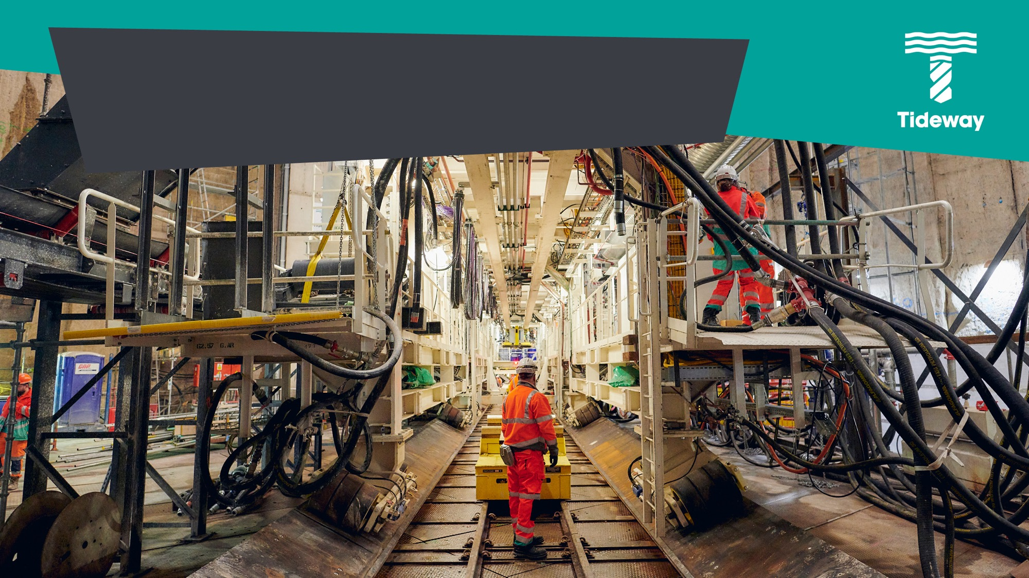

TIDEWAY – Investor UPDATE
September 2021
Notes:
Cover option 4 – Delete as appropriate

Slide 2
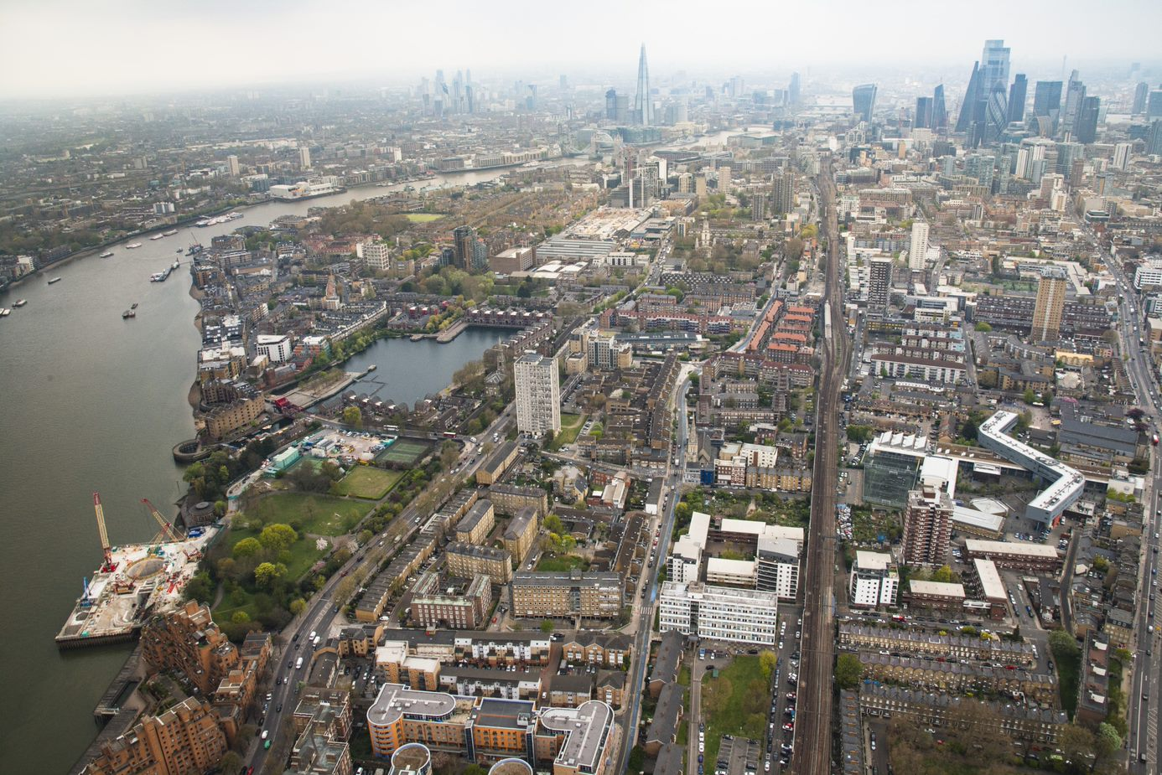
Plan for the morning
08:30 – 09:00 Welcome & Breakfast
09:00 – 09:45 Business update
10:00 – 12:00 Boat tour – sites and program update

Slide 3
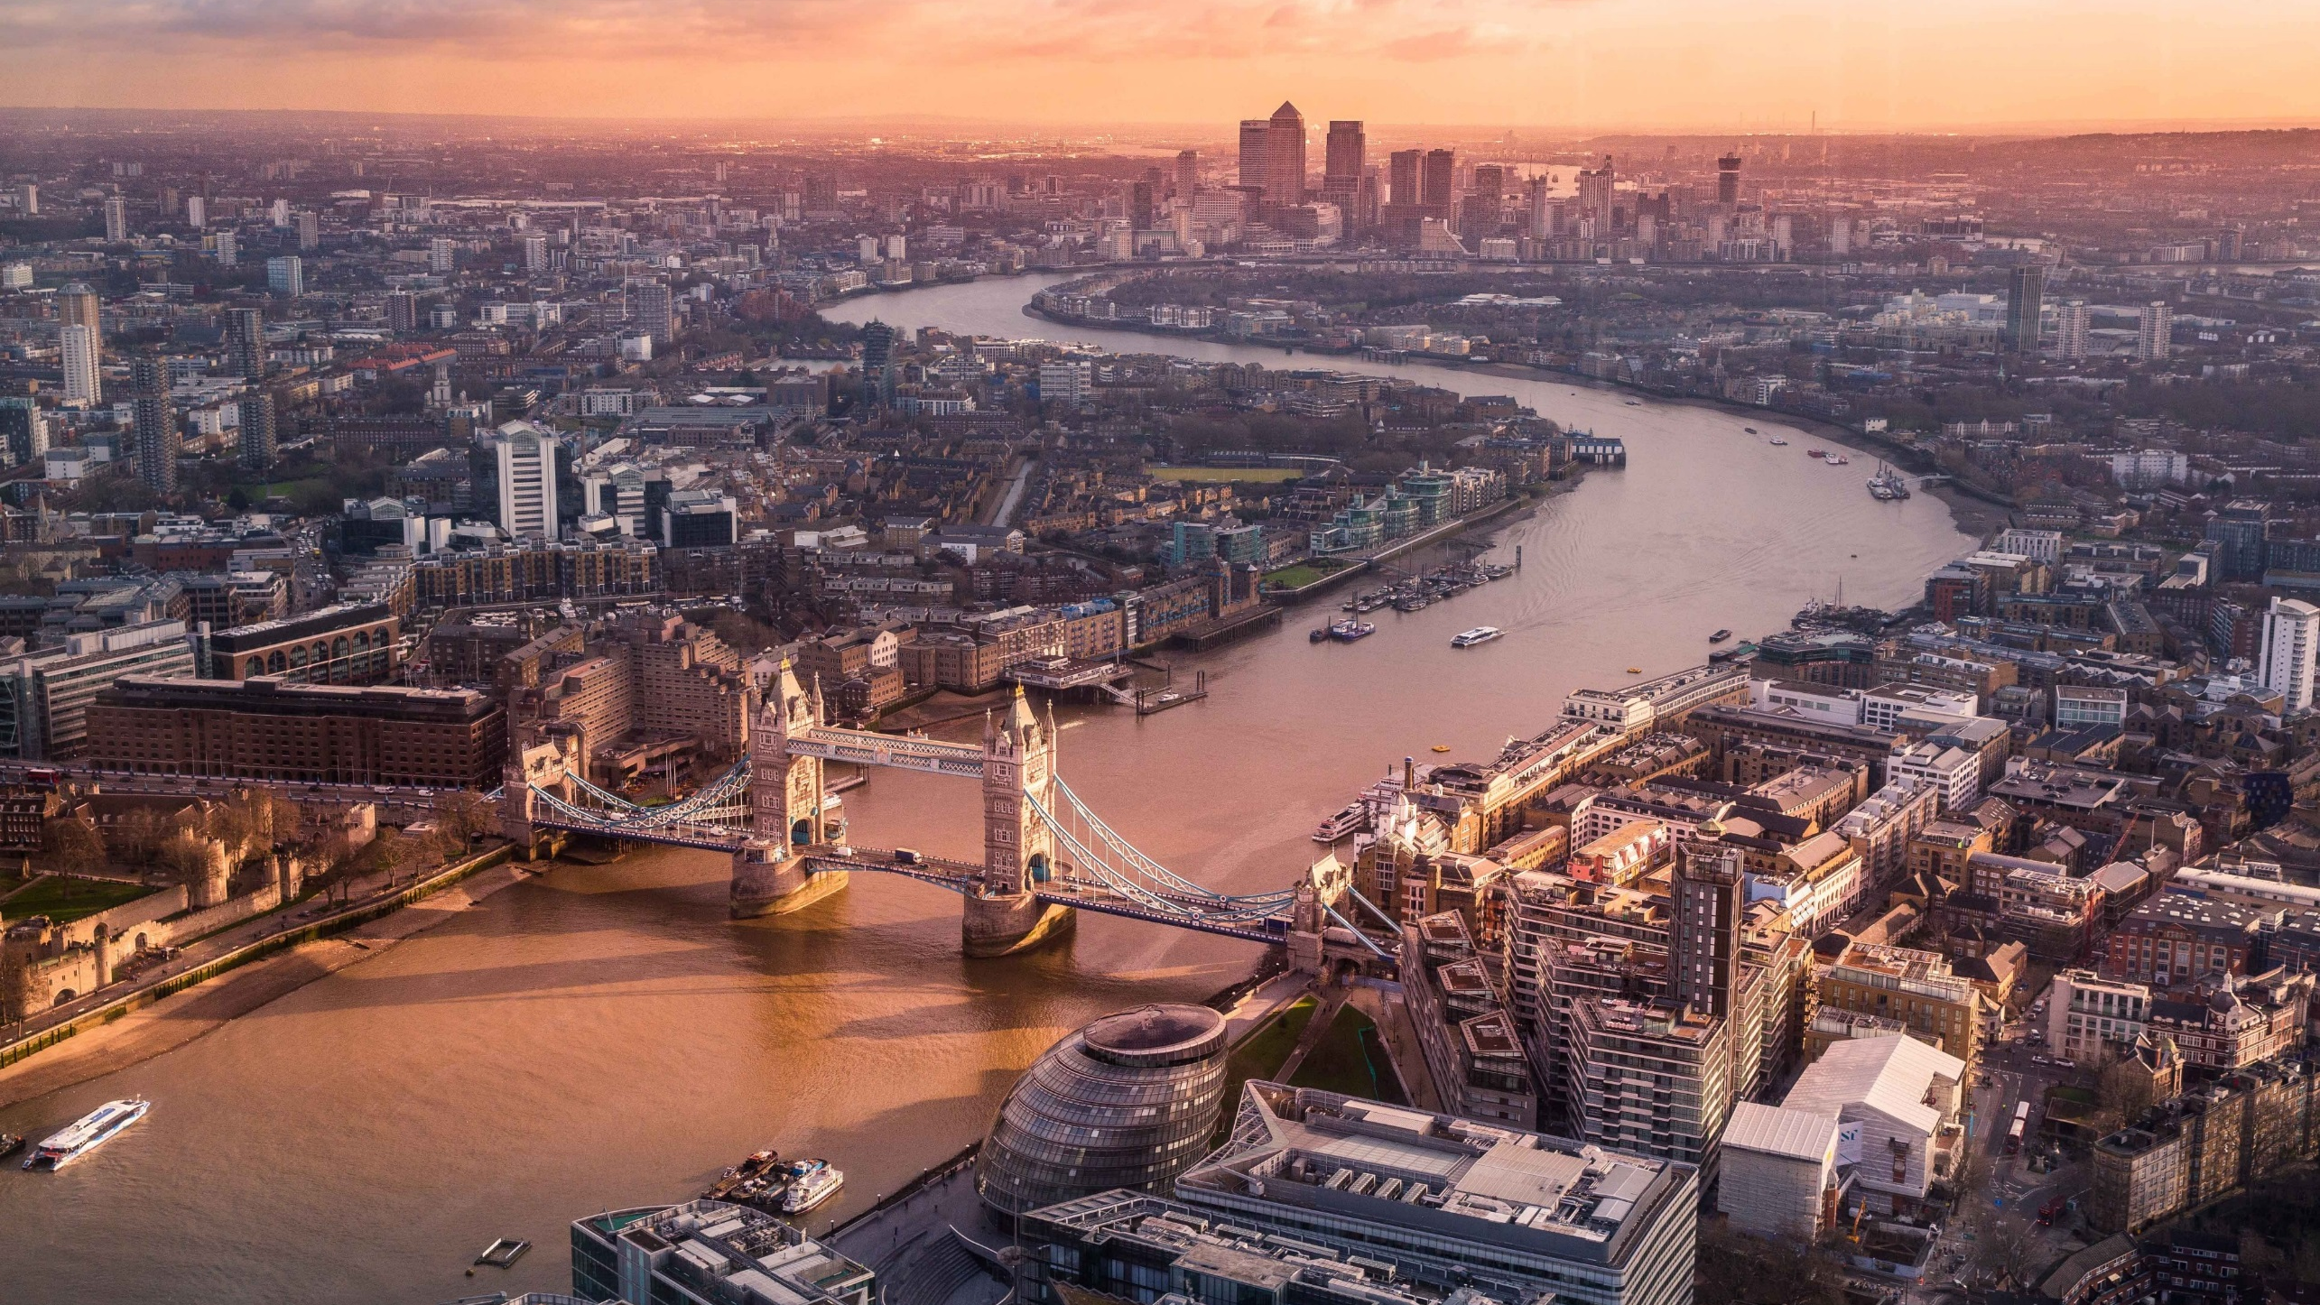


Our challenge is to build a new sewer for London to prevent the frequent pollution of the river Thames
Our vision is to not just clean up the Thames but to promote a change in the relationship between London and Londoners and their river
Notes:
This is why we are here

Slide 4
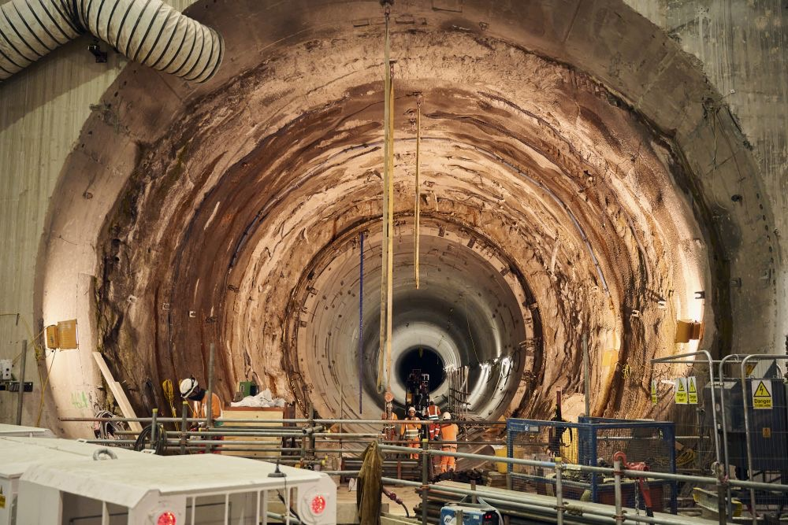
Overview
Project is 69% complete
  22.7km of cumulative primary tunnelling (73% of total)
  8.8km of secondary lining (26% of total)
  The last two of the six tunnel boring machines are in operation in the East section, to complete in June 2022
  All shafts are fully excavated
  Systems integration works are 69% complete
  First parcel of land successfully handed back

Slide 5
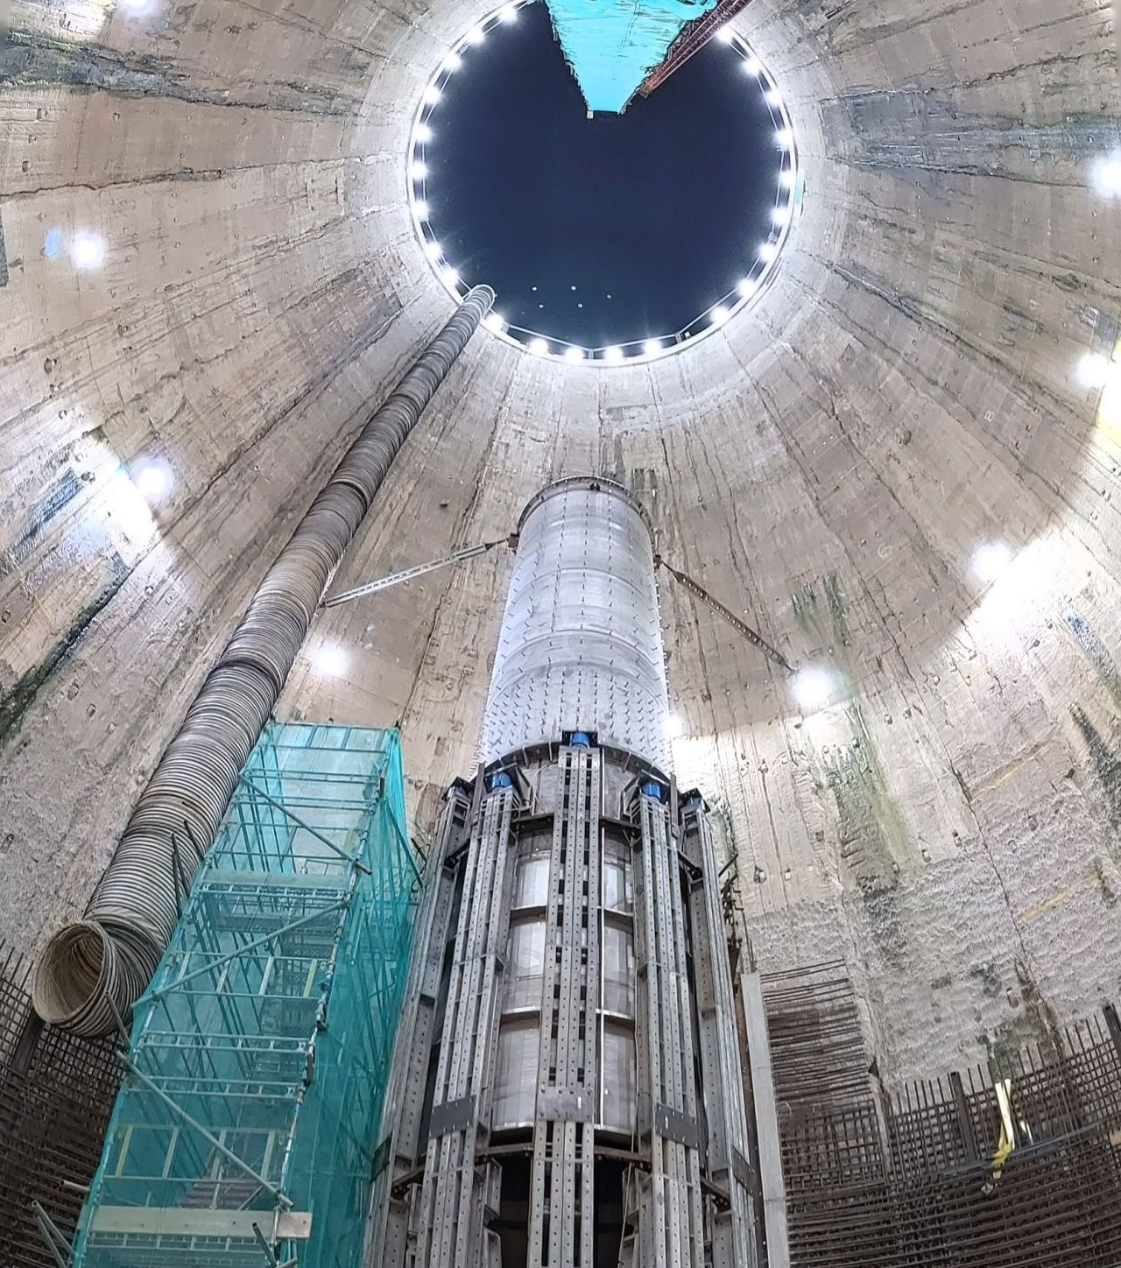
Overview
Business plan project dates:
  October 2023 – start of commissioning
  March 2025 – Handover
  February 2027 – Systems Acceptance
Estimate at Completion (EAC) is £4,181m (versus £3.4bn regulatory baseline)
  Includes forecast impact of COVID-19 on the delivery of the works
  Includes £39m increase following 2021 Baseline (T-24)
Expected annual bill impact to customers continues to be in the £20-25 range
Enough liquidity to complete construction
Baa1 by Moody’s, BBB+ by Fitch, ESG 74/100 by S&P
RCV/Net Debt at 57.1%, Interest Cover Ratio 4.61x

Slide 6
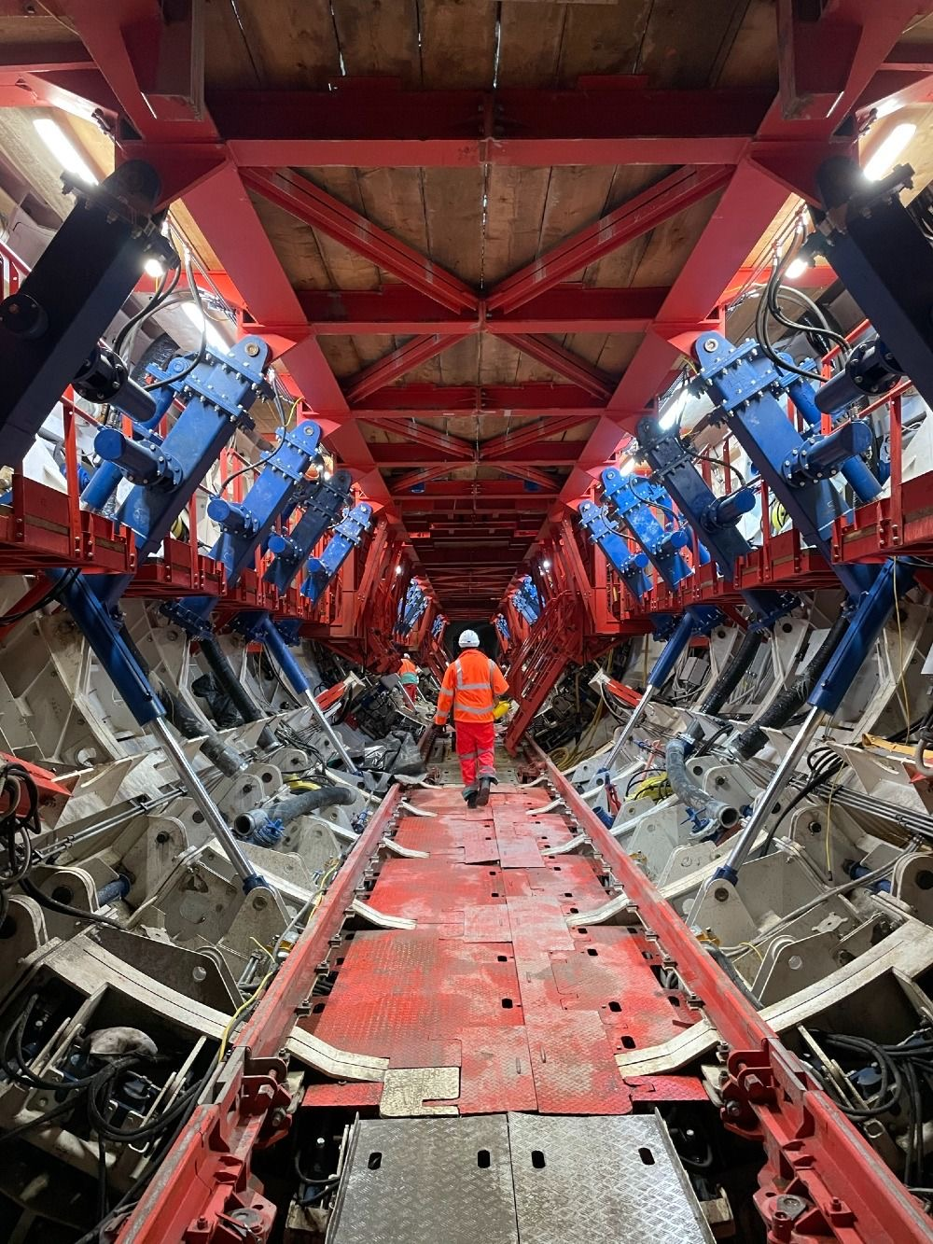
Health, Safety, and Wellbeing
No major injuries occurred as a result of our marine activities, but there has been one major injury in East during construction activities and we saw minor injuries increase in the second half of last year.
The programme’s over-three-day Accident Frequency Rate (AFR, measuring lost-time injuries over a rolling 12-month window) maintained in the region of 0.1.
The Employer’s Project Induction Centre (EPIC) has now reopened and Tideway’s compulsory Health, Safety and Wellbeing training programme has resumed.
Mental Health of the workforce continues to be a major driver for the project – we have trained more than 100 Mental Health First Aiders.

Slide 7

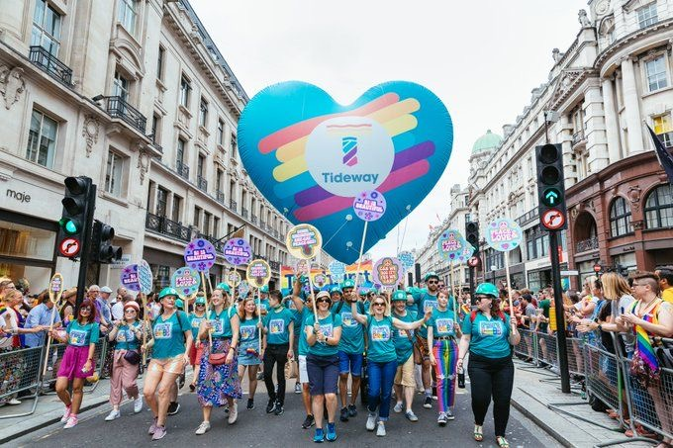

Vision, Legacy, and Reputation
Legacy commitments are 91% on track as of June 2021 against the current target of 85%.
Our annual community survey generated the highest response rate since the start of the project, with commendations for site appearance, site staff and keeping impacts under control, as well as our communications and work with charities.
The More by River strategy has achieved 4.5m tonnes transported by river to date (1.2m this year) and 550,000 HGV journeys avoided to date equivalent to 14m miles or 14,500 tonnes of CO2.
Tideway was named “Project of the Year” at the 2021 Edie Sustainability Leaders Awards.

Slide 8
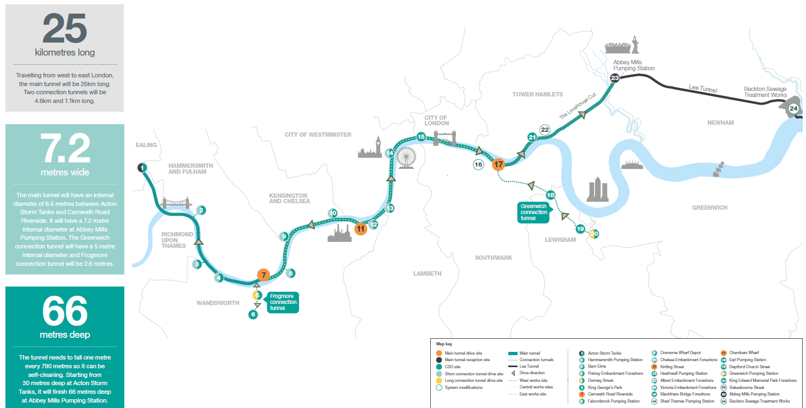
Route and Sites

Slide 9
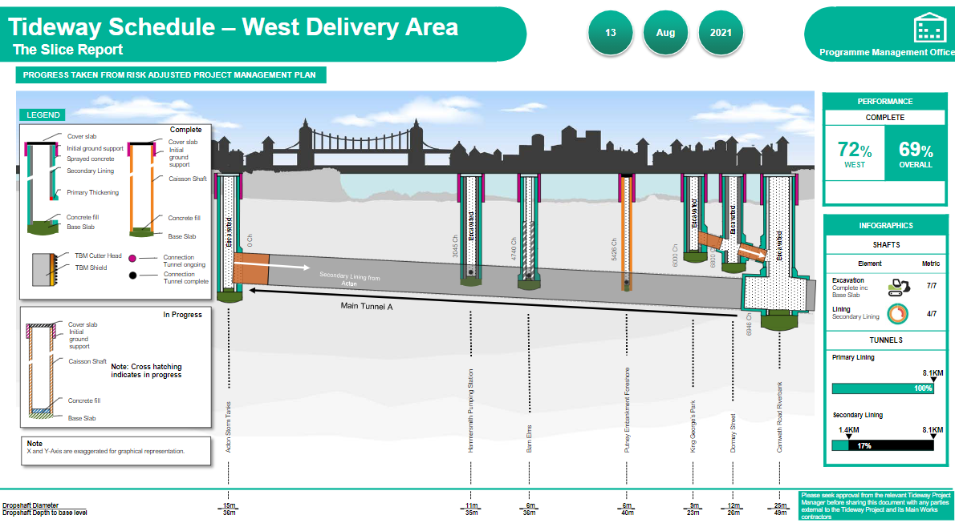
Investment Programme – West

Slide 10
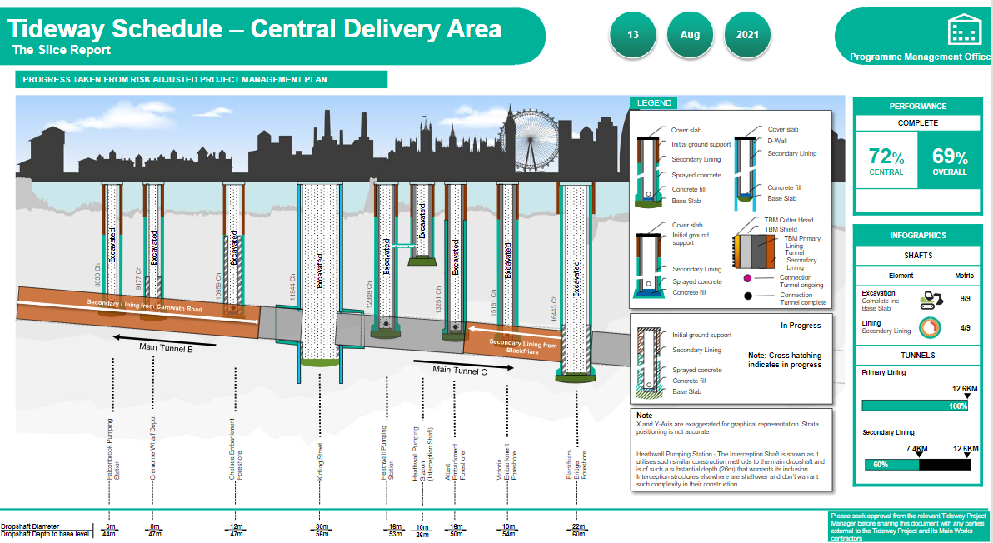
Investment Programme – Central

Slide 11
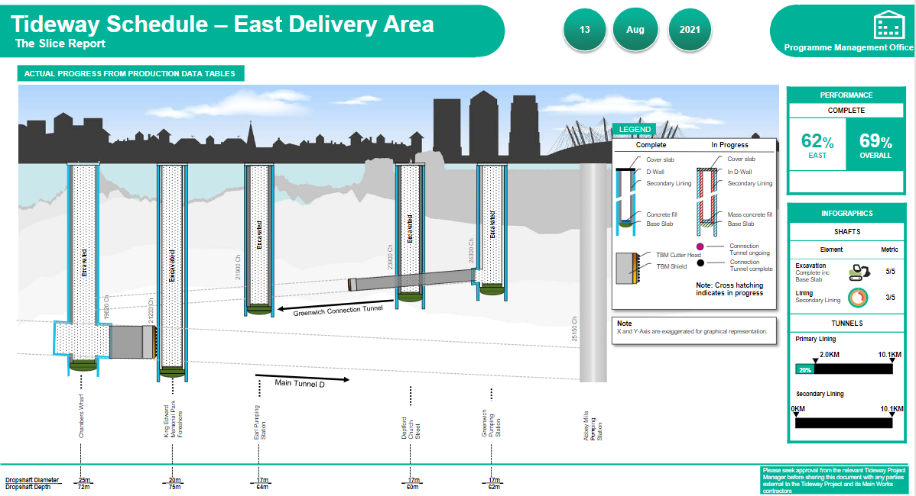
Investment Programme – East

Slide 12
System Integration
There are several mechanical and controls elements of work that must be undertaken to enable the tunnel to be integrated with the existing sewer network and therefore operate as a system.
The overall works progressed to 69% complete.
System
Commissioning Commencement
System Acceptance
Licence Award
Handover
Design/Construction phase
System Commissioning Period
System Acceptance Period
O&M Period
Planning
Pre-System (Worksite) Commissioning

Slide 13
Stakeholders
Ofwat | Ofwat consultation on COVID-19 linked modifications to Tideway licence closed in May, including a higher cost sharing rate for COVID-19 costs Concluding discussions on reforming the Financing Cost Adjustment Implementation of licence changes in Q4 2021/22
Defra | Defra and IPA involved and consulted on delivery progress, updated baseline and licence changes
Thames Water | Improving performance on access to sewers Excellent engagement in 2021 Baseline and approach to phased system commissioning Focus increasing on land hand back process and issues

Slide 14
Financing Activity
Debt facilities
We have raised £2.7bn of long-term debt of which £2,278m has been drawn and is outstanding.
Debt £M | RCF | EIB | RPI loan | RPI bonds | CPI bonds | Nominal | Total
Drawn |  | 620 | 100 | 658 | 275 | 625 | 2,278
Undrawn | 160 | 80 |  | 250 | 75 | 0 | 565
Total | 160 | 700 | 100 | 908 | 350 | 625 | 2,843
This represents 100% of long-term funding needs to cover anticipated construction costs to Handover (March 2025) taking into account the undrawn £160 million Revolving Credit Facility.
Our derivative portfolio includes the swaps hedging the first eight tranches of our £700m EIB loan and £70m of our £300m USPP 2017 notes.
We have received £1,274m from our shareholders in the form of equity and shareholder loans, which was the full commitment at Licence Award. Part of the shareholder loans have been repaid and the current balance is £720.4m.
Fitch affirmed the credit rating at BBB+ with stable outlook. Moody’s maintained the Baa1 rating, but changed the outlook from stable to negative following the operational announcement on the impact of COVID-19 on cost and schedule published in August.

Slide 15
Financing Activity
£2.7bn long term debt
£160m RCF
100% needs to Handover as of March 2021
£1.3bn of debt portfolio matures or resets around 2030 (2027-2032)
Refinancing from 2025 (EIB) and 2027 (bond)
Mar 2021
53.76%
Mar 2021
Net debt/ RCV 57.10%
Index Linked debt as % of RCV
Gearing remains low in line with our equity-first approach. This will grow in the coming years as we progress through construction and draw on the deferred committed debt. The interest coverage ratio remains well above the covenant level.
Mar 2021
76.82%
Mar 2021
ICR
4.61x
Index Linked debt as % of total debt

Slide 16
Sustainable Financing
17 green bonds totalling £1.5bn, £75m green USPP and £160m Sustainability Linked RCF
Sustainable Finance Framework aligned with Green Bond Principles, Green Loan Principles and Sustainability-linked Loan Principles
S&P second opinion on green bonds and loans E1 95/100
ESG ratings and evaluations
  S&P ESG Evaluation 74/100 score
  Our parent company, Bazalgette Equity Ltd continues to be rated Corporate ESG Prime by ISS with a C+ rating, in the top level for transparency (80-100%) and 1st decile ranking in the peer group
Published third Sustainable Finance Report and first Climate Disclosures Report in July 2021
  54 legacy commitments, 90% of live commitments on target
  Positive contribution to 10 SDGs, 27 targets
  Include negative SDG impacts
  Scope 1, 2 and 3 emissions and water usage

Slide 17
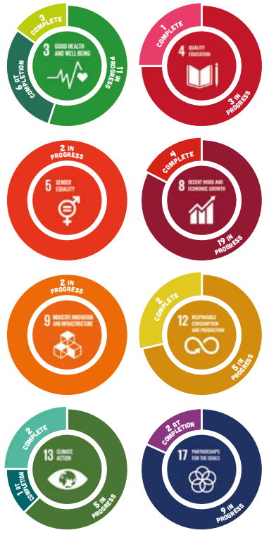
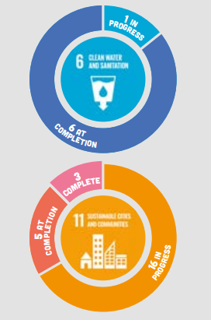
Our sustainable development goals
We have made significant progress towards the delivery of our legacy programme contributing to 10 UN SDGs and 27 targets.
Our 54 legacy commitments have been mapped across multiple SDGs.
  11 of our commitments are complete
  34 are in progress and will be delivered over the next few years as construction completes.
  9 will be measured at completion
  Tideway’s core environmental benefits will make a long-term direct contribution to SDG 6 Clean Water and Sanitation and SDG 11 Sustainable Cities and Communities.
  During construction, Tideway is making a significant contribution to eight other SDGs, and some of these will have a lasting impact and will be handed over to other organisations.

Slide 18
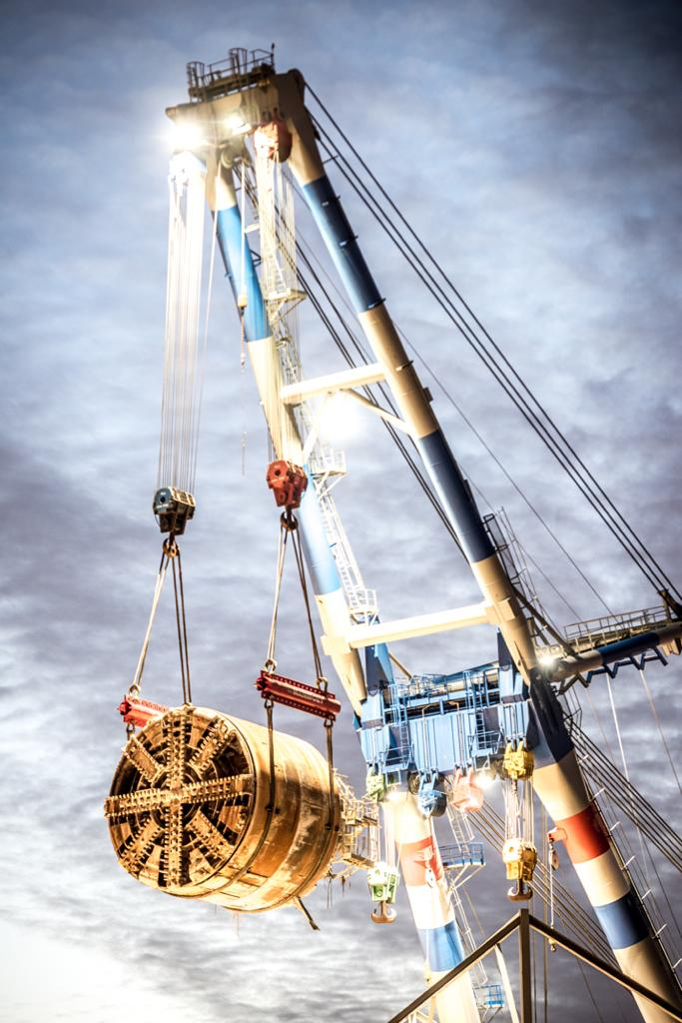
Credit Highlights
Critical UK infrastructure
Strong delivery capability
Supportive regulatory and contractual framework
Stable and highly visible revenue profile
Creditor friendly financial structure
Good progress on project delivery since Licence Award in spite of pandemic
Financing plan substantially de-risked

Slide 19
Q&A

Slide 20
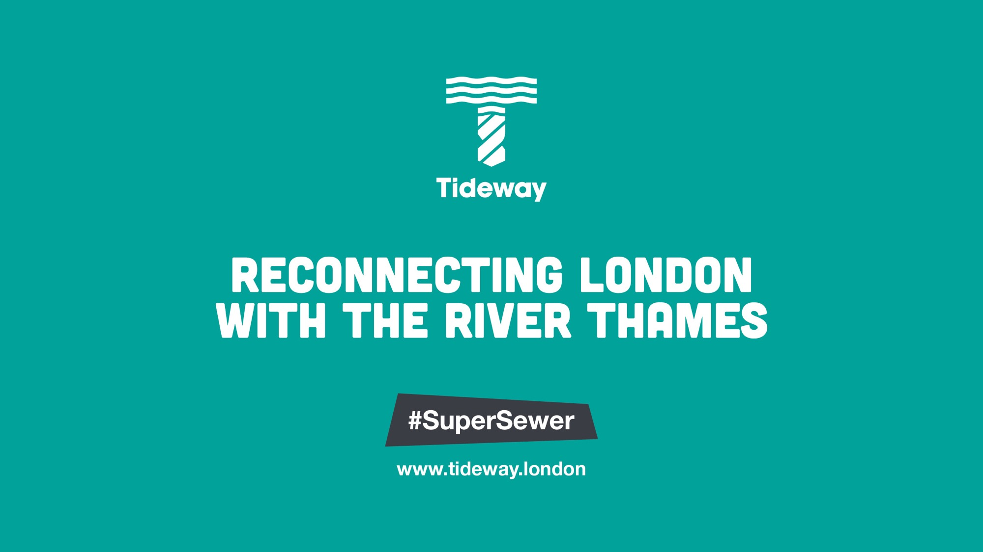
Notes:
Finishing slide

